Slide 1
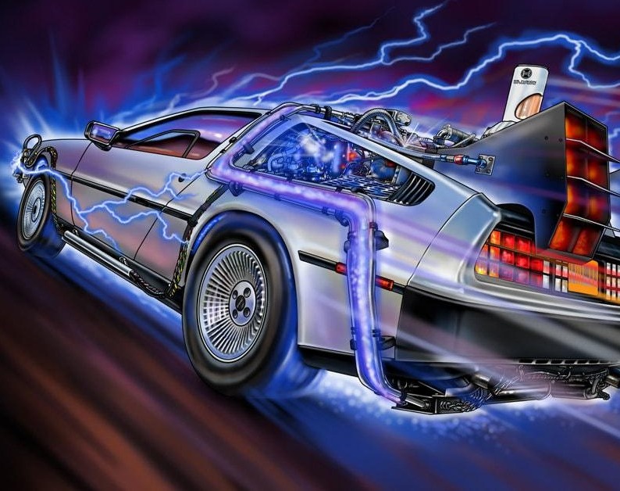



Boolean Brigade presents
Produced by

Slide 2


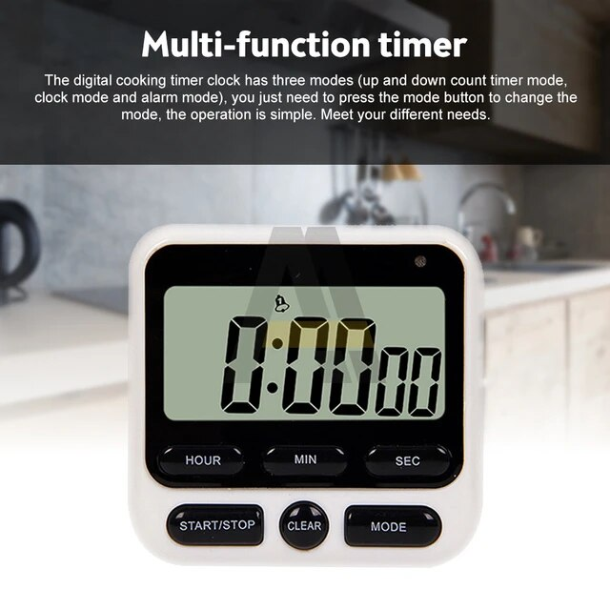

Timekeeping has been a technological challenge for millenia
Keeping time is an important consideration in areas such as navigation, manufacturing, cooking, and Delorean-based time travel
Our project centers around the creation of a dual functionality stopwatch and alarm clock that has two main modes of operation that allows for a “leaderboard” ranking of sorts in which people can keep track of relative scores during a competitive activity
In using our project, we encourage competition among peers
A fitness related example is one in which a group of peers keep track of the best times for planking and the best times for racing from point A to point B
This suggests a motivation to encourage competitive spirits and to promote setting goals for personal achievement

Slide 3
In our design, we have two overarching modes: stopwatch and alarm clock
The stopwatch mode has two sub modes: Slow and Fast
The slow mode corresponds to competitive activities where the longest time is a better score
The fast mode corresponds to competitive activities where the fastest time is a better score
Each mode has a top 3 best times saved
Every time the stopwatch mode is used,the duration of the stopwatch (time duration) is sent to a “leaderboard”, where, depending on the submode you are in, if the new time in is better than one the current high scores, it replaces the high score and adjusts the rest as needed
The alarm clock mode acts as an alternative to the stopwatch mode, simply being used as a normal alarm clock, being programmable
Every time a new high score in either mode is achieved, a sound is played (a sound is also played when the alarm clock reaches 0)

Slide 4
Description of Requirements: Alarm Clocks/Stopwatches – fully functional alarm clocks and stopwatches could be implemented on the FPGA.
There are four main modules: Leaderboard, Stopwatch, 7 Segment Display, and Sound
The Stopwatch Module interacts with all the other modules
The Leaderboard receives a signal from the Stopwatch module and uses it in a specific manner that corresponds to the ranking system between its submodes
Leaderboard had to be configured in such a way that the signal it sends to the sound module varies as a result of input from Stopwatch, in order to produce sounds at different moments when needed
7 Segment Display Module allows for functional stopwatch to be shown on board

Slide 5
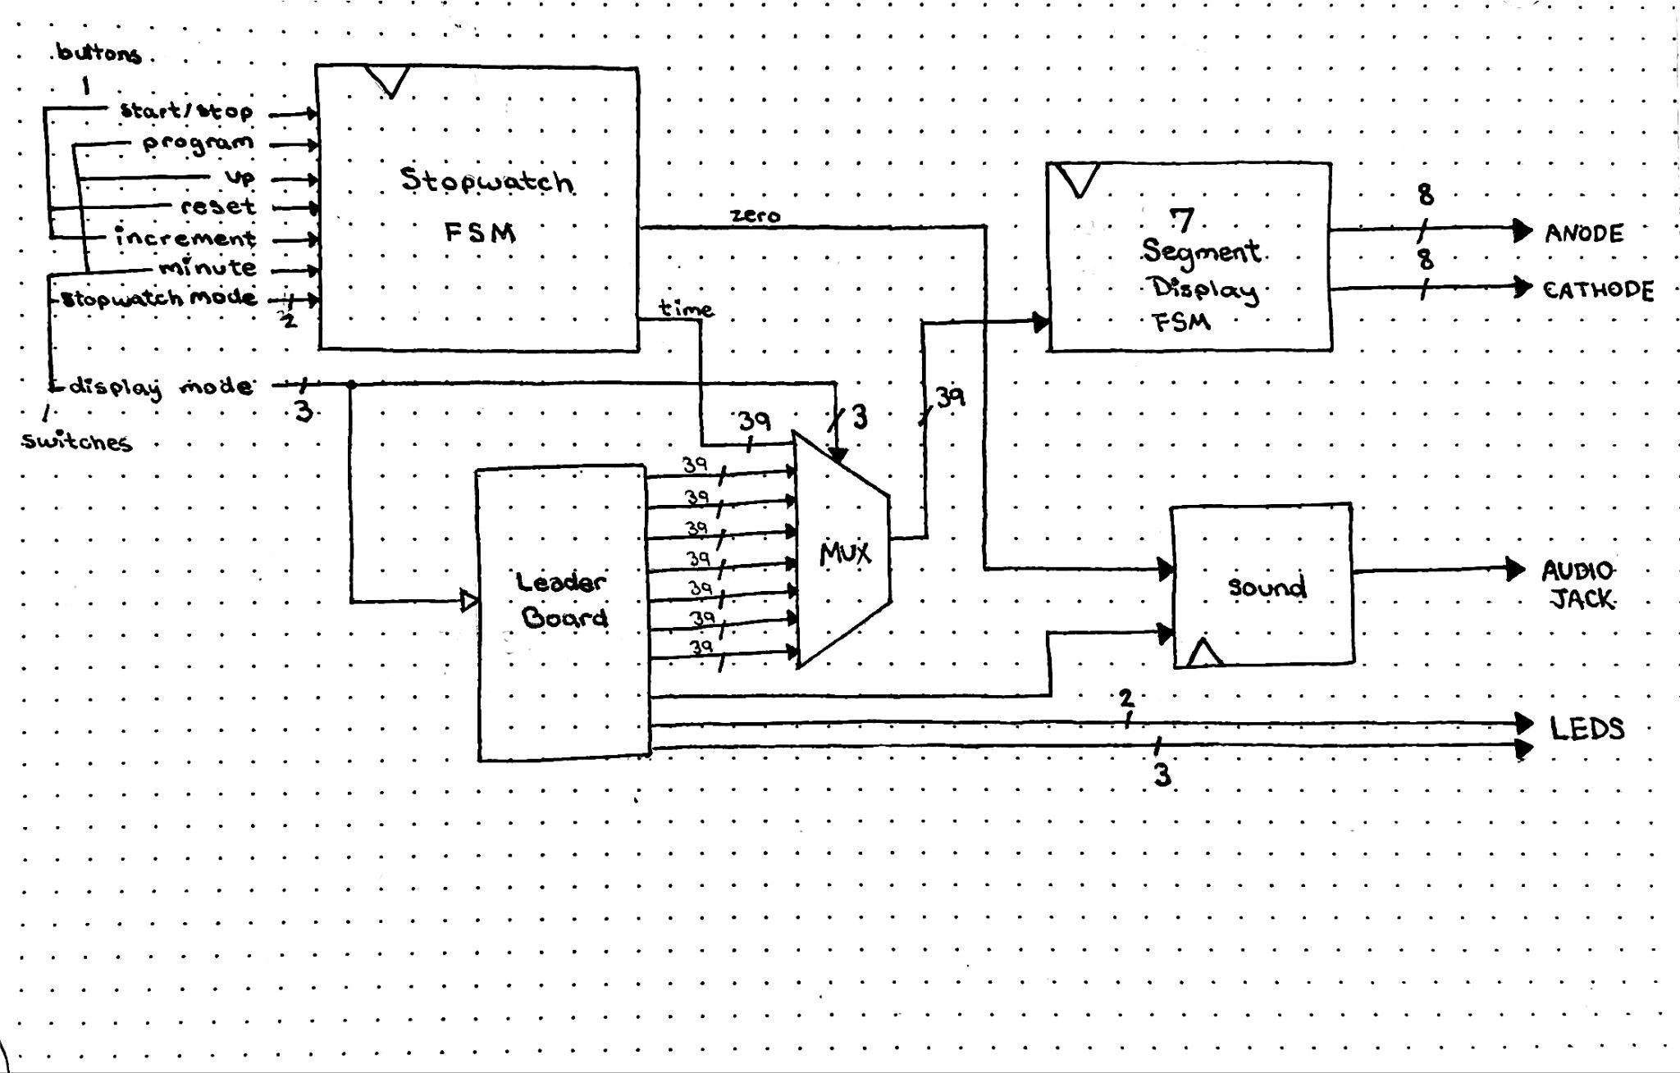

Slide 6
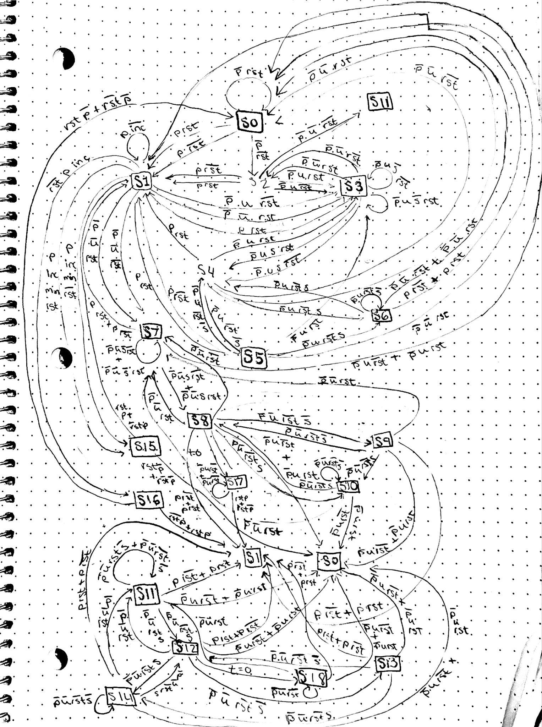
FSM
Diagram
(Stopwatch)

Slide 7
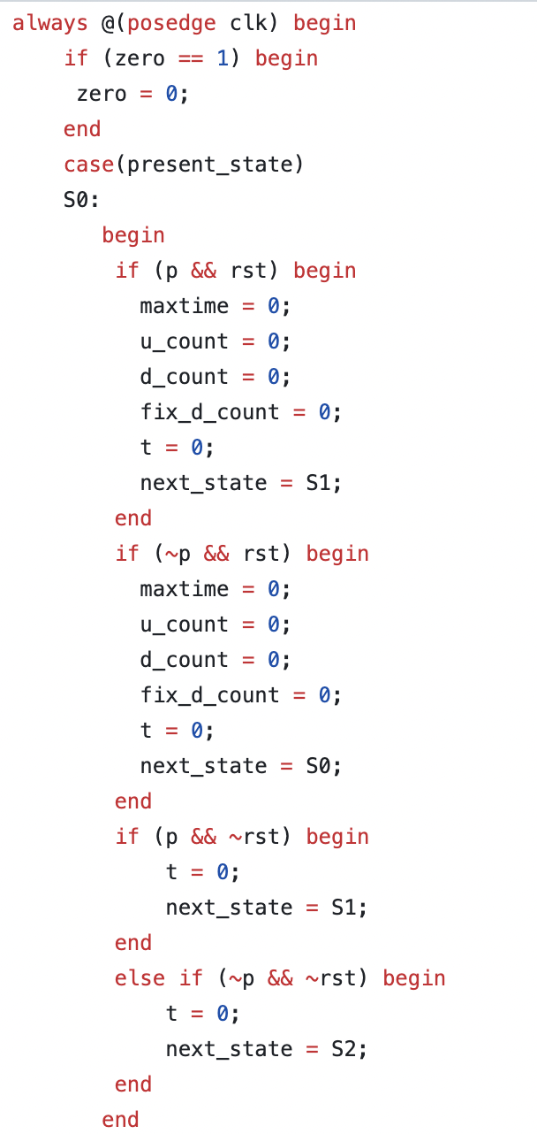
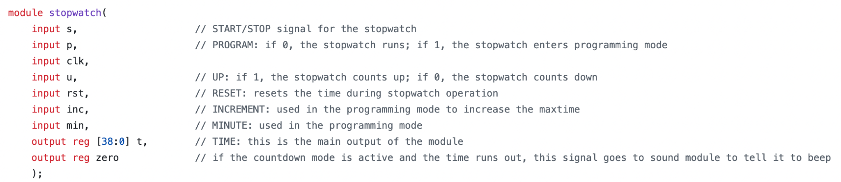


Slide 8
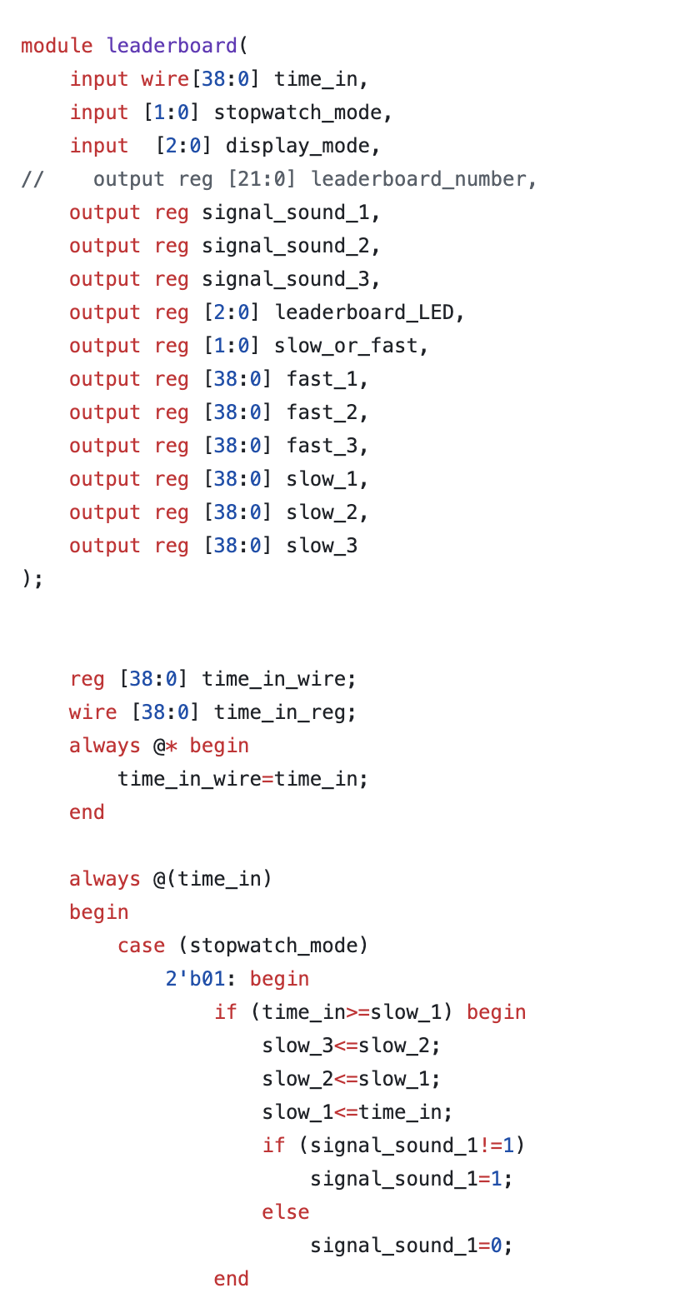

Slide 9

Displaying the time in minutes and seconds
Call me Cyrus! - Defeating the Babylonians: converting from 10ns oscillations to minutes proved extremely difficult due to the base-60 nature of minutes and seconds
Significant computational resources for divider and modulus circuits were required for the final design
We were able to formulate the sound aspect of our design such that the functionality is appropriate for the signals that pass from other modules within our design (playing a short tone based on anticipated kinds signal changes)

Slide 10

We are still attempting to circumnavigate a problem with timing issues
Right now, each of our modules work individually and successfully simulate together. It appears that the stopwatch, leaderboard, and sound work on the board together. However, due to complex timing issues, pushing the time from the stopwatch to the 7-segment displays causes timing violations. However, if fed from a simple counter, the 7-segment display works successfully.
Possible improvements for future use: Implementing a user interface where one can input their initials such that it corresponds to their score if it is a high score

Slide 11
Links to Pictures
https://www.aliexpress.us/item/3256804542437423.html?gatewayAdapt=glo2usa4itemAdapt
https://www.freepik.com/premium-vector/sportsman-run-stopwatch-fitness-exercise-illustration-healthy-people-competition-active-athlete-graphic-runner-cartoon-character-lifestyle-marathon-athletic-activity_9486707.htm

